Slide 1
Python data analysis for beginners
CalHacks 2019 Workshop
10/26/2019

Slide 2
Agenda
01
02
03
04
Introduction
Background information, Dataset
Data Visualization
Forecast
Q&A

Slide 3

BlackRock
~$7 trillion
Assets under management

Slide 4
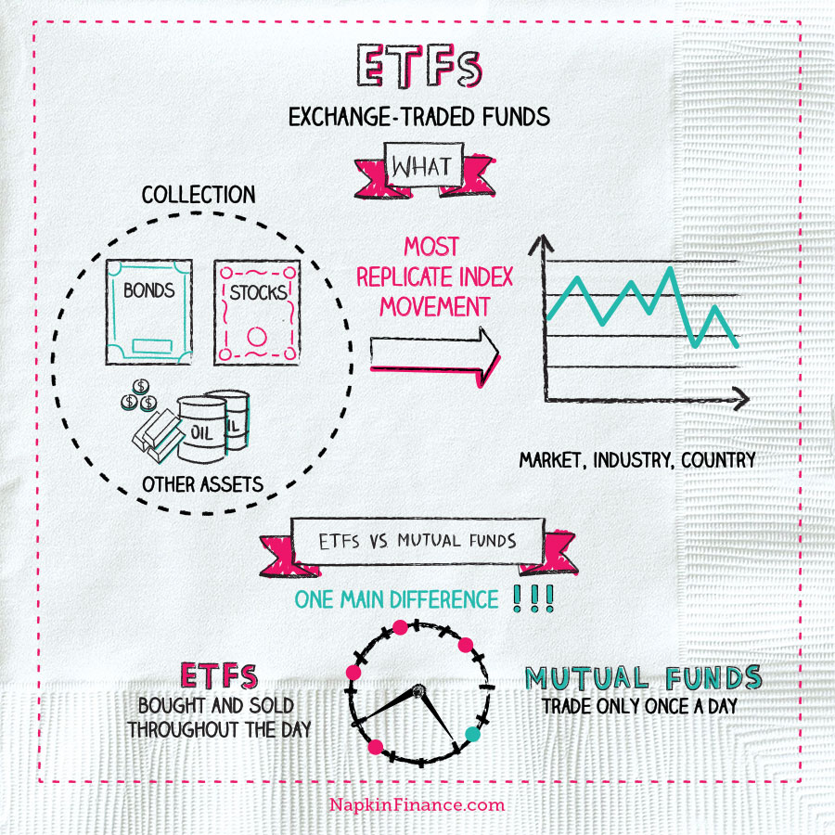
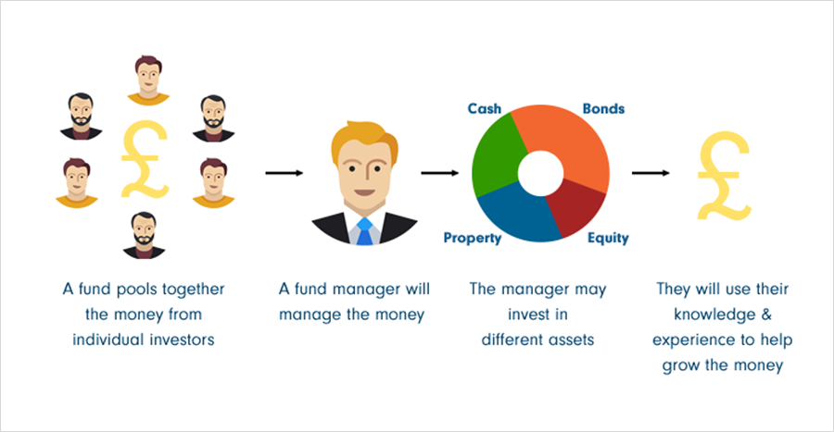
Mutual Funds vs ETFs
MF
ETF
Source: Investopedia

Slide 5
Sectors
Basic materials
Consumer goods
Energy
Consumer cyclical – seasonal
Consumer defensive – daily needs
Energy
Utilities
Technology
Services
Finance and Business
Healthcare
Communication Services
Financial services
Real Estate

Slide 6
Questions?

Slide 7
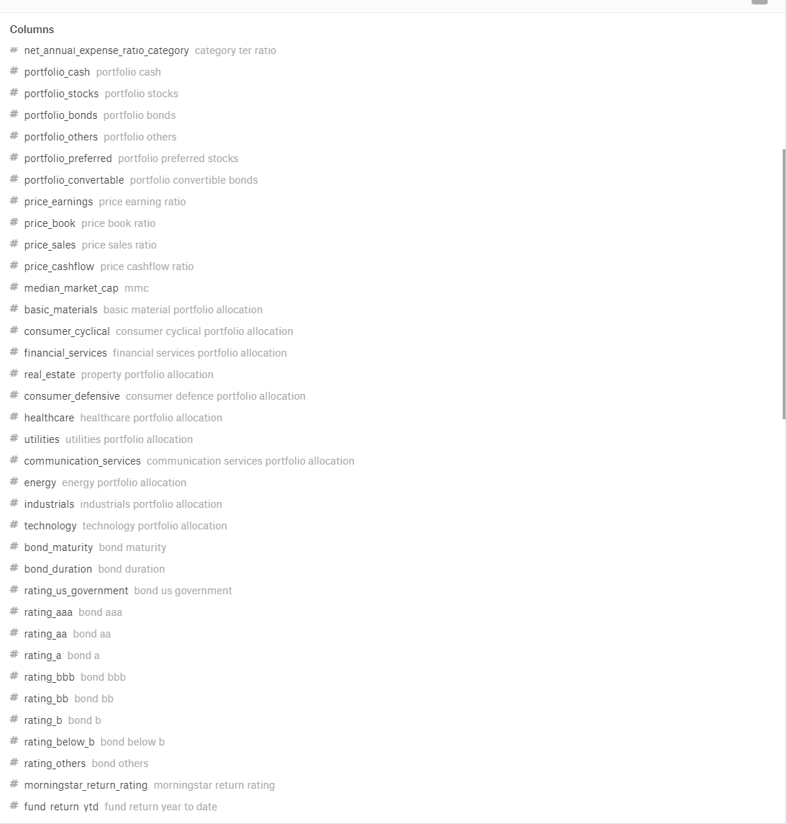
Dataset

Slide 8
Focus of today
1
2
3
Performance
YTD return, over years return, etc.
Composition
Asset allocation in sector
Comparative Performance
Performance across compositions

